Slide 1
CpE111
Introduction to Computer Engineering
Dr. Minsu Choi
CH 4: Digital Hardware

Slide 2
Hardware?
The _______________ of a digital element or system.
How to represent logic 0 and logic 1 states?
  ________, which has units of ________.
  _______________, which has units of _______________.
Two are related: a voltage causes electrical current to flow.
Most digital logic chips use two different voltage ranges to define logic 0 and logic 1 conditions.

Slide 3
Power Supply
All electronic networks require a power supply to operate.
In digital circuits, the power supply is usually modeled as a voltage source with a value that we will denote by V_{DD} (usually _____________).
Ex) schematic diagram of a digital system with a power supply (since the drawing shows the “scheme” used to construct the circuit).

Slide 4
Logic Levels
Logic 0 -> 0v and Logic 1 -> V_{DD} (ex., 5v), in general.
  Low voltage represents logic 0 & high voltage represents 1 -> called ___________.
  High voltage represents logic 0 & low voltage represents 1 -> called ___________.
Two voltage ranges are used in practice.

Slide 5
Digital Integrated Circuits
ICs (______________) = Computer chips.
_________________ (DIP) is very common packaging technology for computer chips.
To build more complex digital systems -> use PCB (__________________).

Slide 6
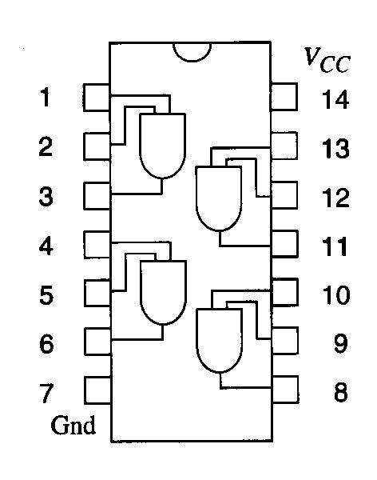
Pin-Out Diagram
The logic functions that a particular chip implements are usually shown by embedding ___________________ in package outline drawings.
Ex) Quad-AND chip. V_{CC} is an alternative notation for the power supply voltage.

Slide 7
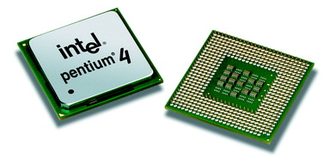
Different Packaging Technologies?
PGA (____________) is used for most microprocessor chips, since ________ can be embedded and larger # of ____ can be allocated.
There are different variations – INTEL’s ________ and AMD’s ___________.

Slide 8
IC Integration Levels
SSI (Small-Scale Integration): ICs with a few gates.
MSI (Medium-Scale Integration): ICs with a few hundred gates.
LSI (Large-Scale Integration): _________ gates.
VLSI (Very Large-Scale Integration): a few ________ gates.
ULSI (Ultra Large-Scale Integration): around one ______ gates.
Ex) INTEL Pentium 4 processor has about ____ million gates.

Slide 9
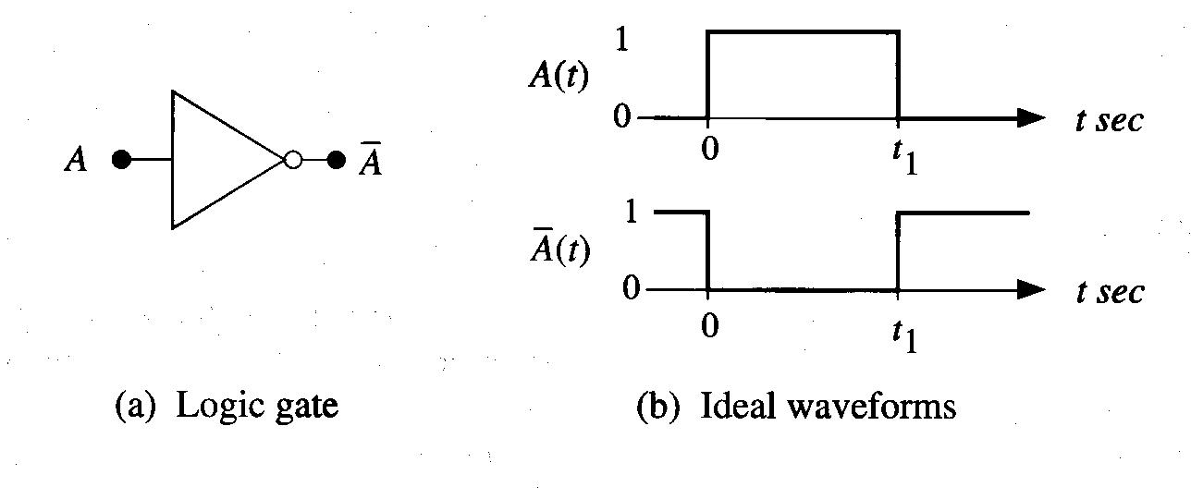
Logic Delay Times
________ ( a plot of a variable as a function of time) is used to measure the behavior of a gate.
Ex)
In the real world, a voltage cannot chance instantaneously.

Slide 10
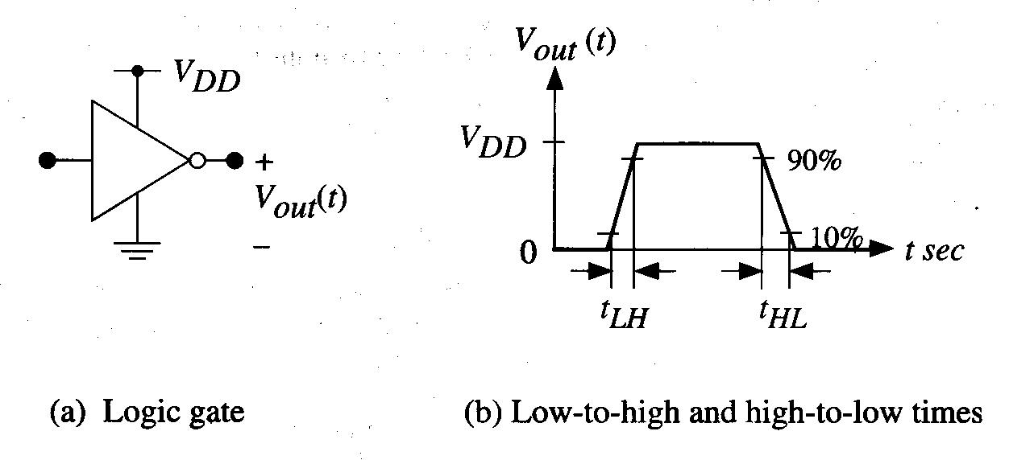
Output Switching Times
Two time intervals must be considered:
  t_{LH}, the output _____________, also called the _______, t_{r}.
  t_{HL}, the output _____________, also called the _______, t_{f}.
  By convention, these time intervals are not measured between 0v to VDD, but represent the transition required between ___________ voltage levels, as shown below.

Slide 11
Continued,
The minimum amount of time needed for the gate to switch from 0 to 1 then back again is given by:
The maximum switching frequency is:
=max # of logic transitions that the gate can make in 1 sec.
Ex)

Slide 12
Propagation Delay
It can be hard to keep track of both delay times for every logic gate.
At the logic design level, it is simpler to introduce a single delay time that represents an ____________, called “propagation delay”, from the input to the output.
This is to include the physical delay of a logic signal as it “_________” through a chain of gates.

Slide 13
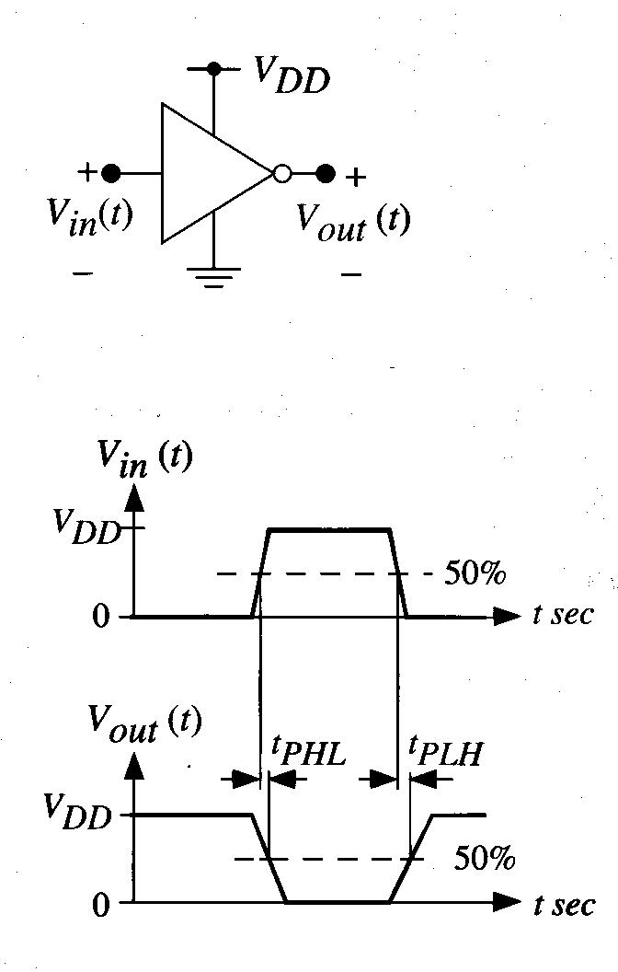
Inverter Gate Example
Then, t_{P} (=propagation delay) = 1/2 (t_{PHL} + t_{PLH}) or =max(t_{PHL}, t_{PLH}), alternatively.

Slide 14
Fan-In & Fan-Out
The fan-in of a digital logic gate refers to the __________________.
Ex) inverter has fan-in of __ and NAND2 has fan-in of __.
The fan-in provides information about intrinsic speed of the gate -> the propagation delay __________ with the fan-in.
Ex)

Slide 15
Continued,
The switching time of an electronic gate depends on the number of gates that are _______ (or _________) at the output.
The fan-out of a gate is the number of gates that are driven by the output, and it depends how the gate is used in the logic chain -> increasing the fan-out __________ the logic flow through the gate.
If no additional gate -> no load (fan-out=0)
Fan-out=1 ->
Fan-out=N ->

Slide 16
Logic Cascades and Delays
Ex) linear chain of 4 inverters.

Slide 17
Continued,
Ex) Inverter chain with increased internal delay.

Slide 18
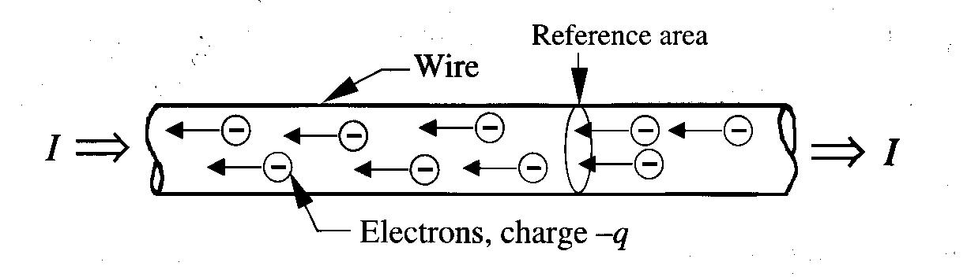
Basic Electric Circuits
Let’s consider electric current flowing through a wire.
The current I (measured in ampares, A) represents the flow of charge (denoted by Q, measured in units of _______, C) across a reference area shown.
So, the current is the _______________ of the charge across the area, as given by the derivative; __________.
1A = ______ crossing the reference plane.
Electrons flow right to left and current flows in the direction of positive charge (__________).
The voltage on the left side is _______ than the right side.

Slide 19
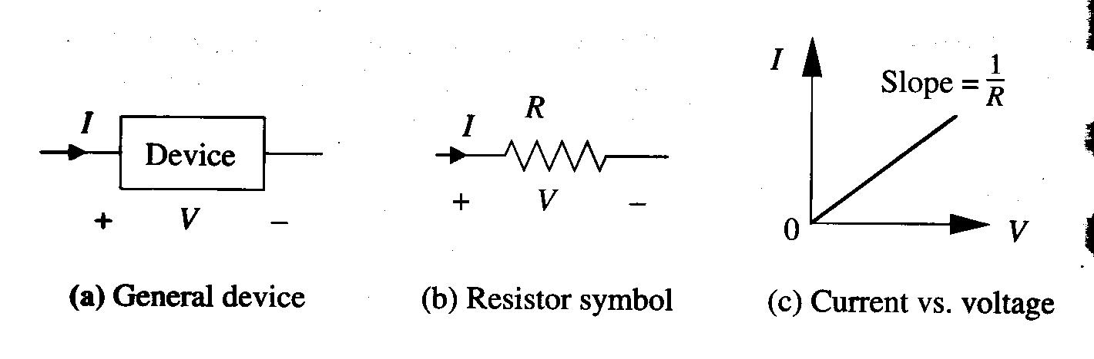
Resistance
Every electronic device has a natural tendency to “____” the flow of charge -> Resistance (parameter R is used).
_______
The unit of resistance is the ________.
Ex) 1Ω resistor admits 1A of current with 1v applied across it -> ___________.

Slide 20
Power Dissipation (P) of Resistor
The power dissipation of a resistor in units of _________ is given by:
_______________ (since V = IR, Ohm’s law).
Ex) Power dissipation of a resistor at 15v and 5A.

Slide 21
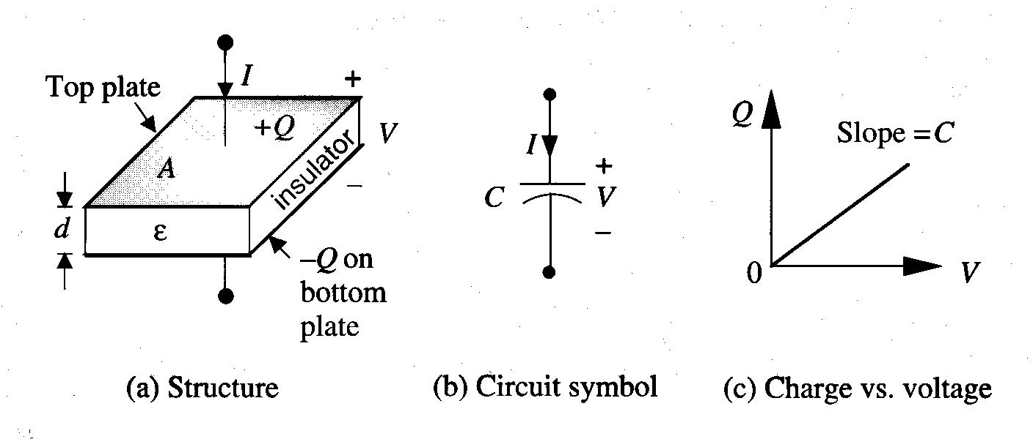
Capacitance
A parameter that describes how a particular device can store _____________.
Ex) Parallel-plate capacitor.

Slide 22
Continued,
The device consists of two metal plates that are separated from each other by an insulating layer such as glass.
  A voltage V is applied to the plates as shown.
  A charge of ____ is induced on the top plate and a charge of ____ is induced on the bottom plate.
  Then, the amount of charge Q stored is _______.
The unit of capacitance is the farad (F) such that C = Q/V.

Slide 23
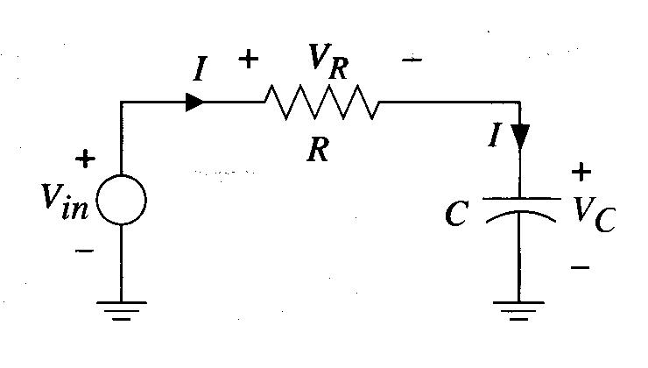
The RC (Resistor-Capacitor) Circuit
Digital switching networks are often modeled by using the series-connected RC circuit shown below.

Slide 24
Continued,
Three components carry the same current I, since they are connected in _______.
But three different voltages are shown; V_{in} (___________), V_{R} (____________) and V_{C} (_____________).
The relationship among these voltages is from _________________ (KVL);
  Sum of voltage rises = sum of voltage drops.
  ______________
  So, V_{R} & V_{C} respond to changes in the input voltage V_{in}.

Slide 25
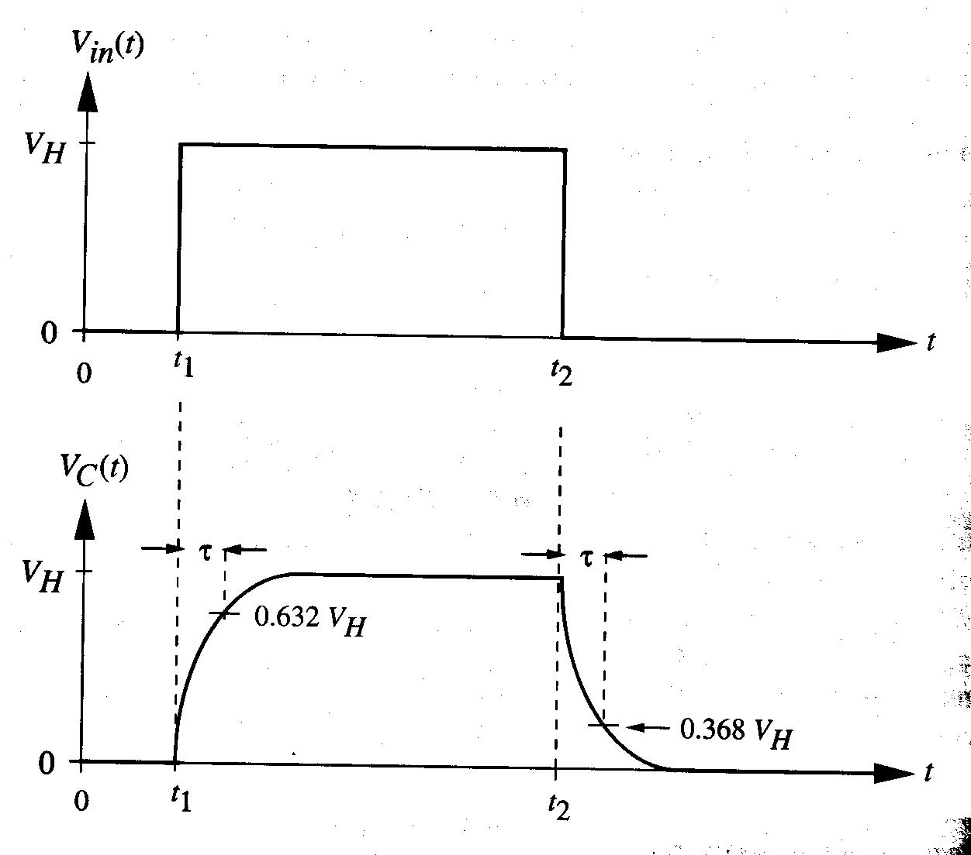
RC Circuit Behavior
Input voltage V_{in}(t) from 0v to a high voltage V_{H} at time t₁ and then back to 0v at time t₂.
Then, capacitor voltage V_{C}(t)?

Slide 26
Continued,
When V_{in} is charged to a high voltage V_{H}, current starts flowing. The current is given by; ________ (current is the time rate of change of the charge).
So, the current “______________” and the capacitor charge Q_{C} increases with time; ____________.
When input voltage switches back down to 0v, V_{C} decays to 0v.
-> Q_{C}goes up, then V_{C} goes up; Q_{C} goes down, then V_{C} goes down with time.

Slide 27
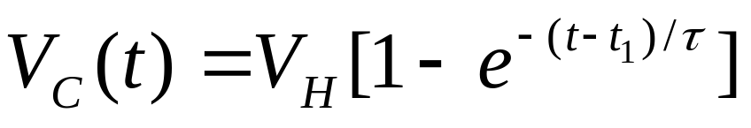
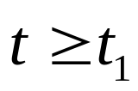
Detailed Analysis
The time delay as the capacitor voltage changes from 0 to V_{H} is due to the resistance R in the circuit, which impedes the current flow.
  -> V_{R} = IR
  -> V_{R} = V_{in} – V_{C} (by KVL)
  So, I = (V_{in} – V_{C})/R
When the capacitor is charged, the voltage increases according to the formula:
-> ______________________: (e is “Euler e” and e = 2.71828… and τ (tau) is called the ___________ and ________ seconds).

Slide 28
Continued,
τ represents the delay for the capacitor voltage to change from 0v to a certain high level that is chosen at time τ seconds from t₁.
-> The voltage at this time is…
Small τ means ____ transition.
Large τ means ____ transition.

Slide 29
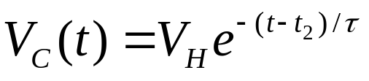

Continued,
The discharge event is similar:

Slide 30
Example
Consider an RC circuit with values of R=1000Ω and C=10⁻¹²F.
What if we reduce R= R=1000Ω to 500Ω and C=5⁻¹³F?
Keeping R=1000Ω, how can we achieve τ=0.25ns?

Slide 31
Application to Digital Circuits
Transitions 0->1 and 1->0 take time.
The switching time of every digital electronic network is governed by any __________ and ___________ in the network.
________________: unwanted resistance and capacitance contributions that cannot be eliminated and that act to ________ the network response.
So, keeping R and C ________________ is desired!

Slide 32
Transmission Lines
Another type of logic delay arises when we analyze the physics of transmitting a voltage along a wire.
Transmission line signal delay (= t_{s}) + the voltage at the end of transmission line takes time to “________” to the final value = t_{d}.

Slide 33
Program Completed
University of Missouri-Rolla
© 2003 Curators of University of Missouri

